Slide 1
Subword Regularization

Slide 2
Byte pair encoding
Subword regularization

Slide 3
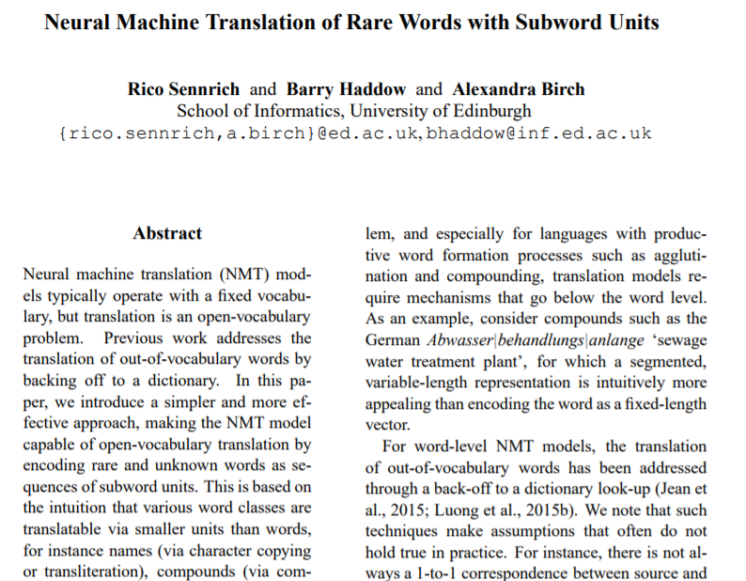
BPE
Subword Regularization
1. Byte pair encoding (BPE)
Purpose:
addressing out-of-vocabulary
Previous works
Mask as ‘[unk]’ token
Employ back-off list
Cause information loss
Unrealistic assumption

Slide 4
BPE
Subword Regularization
1. Byte pair encoding (BPE)
Step
Divide words to characters
Ex) [‘ABC’, ‘ABD’, ‘ZAB’] -> [‘A,B,C’, ‘A,B,D’, ‘Z,A,B’]
Find the most frequent pair
Ex) (A,B) : 3, (B,C) : 1, (B,D) : 1, (Z,A) : 1
Merge the most frequent pair to a single token
Ex) ‘A,B’ -> ‘AB’
Repeat n times

Slide 5
BPE
Subword Regularization
1. Byte pair encoding (BPE)
Example
Iteration 0
Words | ‘l o w </w>’: 5, ‘l o w e r </w>’: 2, ‘n e w e s t </w>’ : 6, ‘w i d e s t </w>’ : 3
Tokens | l, o, w, e, r, n, w, s, t, I, d, </w>
‘e’, ‘s’
Iteration 1
Words | ‘l o w </w>’: 5, ‘l o w e r </w>’: 2, ‘n e w es t </w>’ : 6, ‘w i d es t </w>’ : 3
Tokens | l, o, w, e, r, n, w, s, t, I, d, </w>, es
e : unique character exist
s : all ‘s’ are merged to ‘es’

Slide 6
BPE
Subword Regularization
1. Byte pair encoding (BPE)
Example
Iteration 1
Words | ‘l o w </w>’: 5, ‘l o w e r </w>’: 2, ‘n e w es t </w>’ : 6, ‘w i d es t </w>’ : 3
Tokens | l, o, w, e, r, n, w, t, I, d, </w>, es
‘es’, ‘t’
Iteration 2
Words | ‘l o w </w>’: 5, ‘l o w e r </w>’: 2, ‘n e w est </w>’ : 6, ‘w i d est </w>’ : 3
Tokens | l, o, w, e, r, n, w, t, I, d, </w>, es, est
es : all ‘es’ are merged to ‘est’

Slide 7
BPE
Subword Regularization
1. Byte pair encoding (BPE)
Example
Iteration 2
Words | ‘l o w </w>’: 5, ‘l o w e r </w>’: 2, ‘n e w est </w>’ : 6, ‘w i d est </w>’ : 3
Tokens | l, o, w, e, r, n, w, t, I, d, </w>, est
‘est’, ‘</w>’
Iteration 3
Words | ‘l o w </w>’: 5, ‘l o w e r </w>’: 2, ‘n e w est</w>’ : 6, ‘w i d est</w>’ : 3
Tokens | l, o, w, e, r, n, w, t, I, d, </w>, est ,est</w>
</w> : unique character exist
es : all ‘est’ are merged to ‘est</w>’

Slide 8
BPE
Subword Regularization
1. Byte pair encoding (BPE)
Example
Iteration 3
Words | ‘l o w </w>’: 5, ‘l o w e r </w>’: 2, ‘n e w est</w>’ : 6, ‘w i d est</w>’ : 3
Tokens | l, o, w, e, r, n, w, t, I, d, </w>, est</w>
‘o’, ‘w’
Iteration 4
Words | ‘l ow </w>’: 5, ‘l ow e r </w>’: 2, ‘n e w est</w>’ : 6, ‘w i d est</w>’ : 3
Tokens | l, o, w, e, r, n, w, t, I, d, </w>, est</w>, ow
w : unique character exist
o : all ‘o’ are merged to ‘ow’

Slide 9
BPE
Subword Regularization
1. Byte pair encoding (BPE)
Example
After 10 iteration
Words | ‘low</w>’: 5, ‘low e r </w>’: 2, ‘newest</w>’ : 6, ‘w i dest</w>’ : 3
Tokens | low</w>, low, e, r, </w>, newest</w>, w, I, dest</w>
* [unk] token at test time
Unknown characters
All occurrences in the training text have been merged into larger symbols

Slide 10
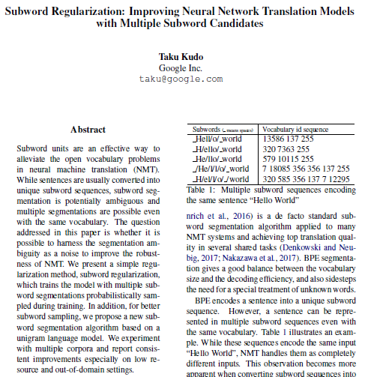
BPE
Subword Regularization
2. Subword Regularization

Slide 11
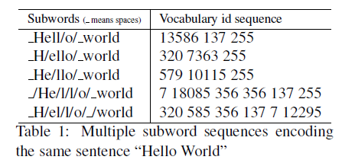
BPE
Subword Regularization
2. Subword Regularization
Introduction
BPE effectively handles out-of-vocabulary
BPE encodes a sentence into a unique subword sequence
Good balance between the vocab size and the decoding efficiency
A sentence can be represented in multiple subword sequences
At training time:
Multiple segments can make the model robust to noise and segmentation errors, as they can indirectly help the model to learn the compositionality of words.

Slide 12
BPE
Subword Regularization
2. Subword Regularization
Introduction
The author propose a simple NMT training algorithm to integrate multiple segmentation candidates without changing NMT model structure
The author propose a new subword segmentation algorithm based on a language model (unigram) which provides multiple segmentations with probabilities.

Slide 13
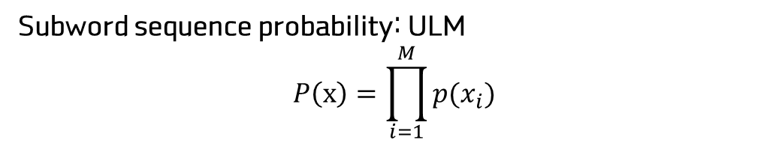
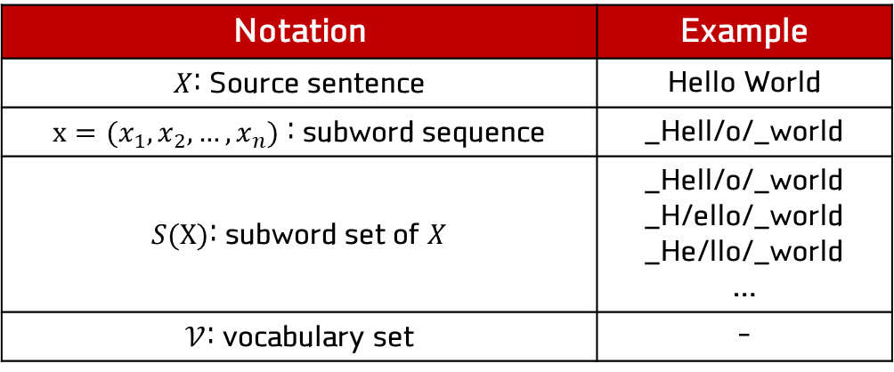
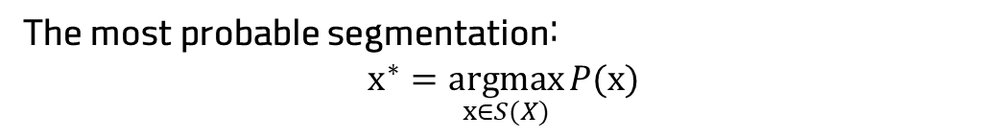
BPE
Subword Regularization
2. Subword Regularization
Subword segmentation (Unigram Language Modeling, ULM)
a) Definition
Notation | Example
$X$: Source sentence | Hello World
$x=(x_{1}, x_{2}, …, x_{n})$ : subword sequence | _Hell/o/_world
$S(X)$: subword set of $X$ | _Hell/o/_world _H/ello/_world _He/llo/_world …
$𝒱$: vocabulary set | -
Subword sequence probability: ULM
$$P\left(x\right)=\prod_{i=1}^{M}{p(x_{i})}$$
The most probable segmentation:
$$x^{∗}=\underset{x∈S(X)}{argmax}{P(x)}$$

Slide 14

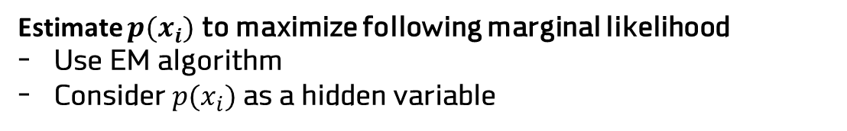
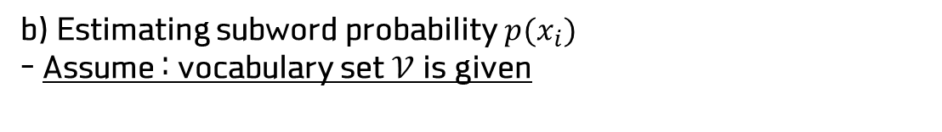
BPE
Subword Regularization
2. Subword Regularization
Subword segmentation (Unigram Language Modeling, ULM)
b) Estimating subword probability $p(x_{i})$
- Assume : vocabulary set $𝒱$ is given
Estimate $p(x_{i})$ to maximize following marginal likelihood
Use EM algorithm
Consider $p(x_{i})$ as a hidden variable

Slide 15
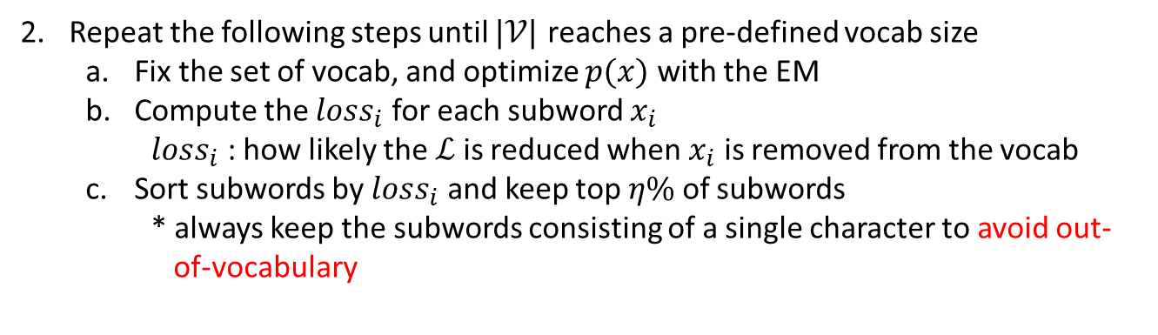
BPE
Subword Regularization
2. Subword Regularization
Subword segmentation (Unigram Language Modeling, ULM)
c) But!!! Vocabulary set $𝒱$ is also unknown
Heuristically make a big seed vocabulary from the training corpus
Use the union of all characters and the *most frequent substrings in the corpus
Can employ BPE to obtain frequent substrings
Repeat the following steps until $|𝒱|$ reaches a pre-defined vocab size
Fix the set of vocab, and optimize $p(x)$ with the EM
Compute the $loss_{i}$ for each subword $x_{i}$
$loss_{i}$ : how likely the $ℒ$ is reduced when $x_{i}$ is removed from the vocab
Sort subwords by $loss_{i}$ and keep top $η\%$ of subwords
* always keep the subwords consisting of a single character to avoid out- of-vocabulary

Slide 16
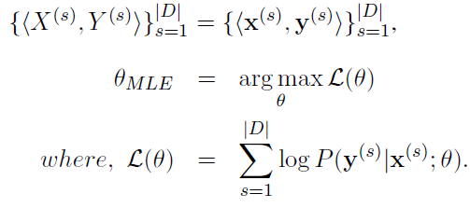
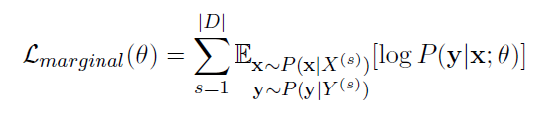
BPE
Subword Regularization
2. Subword Regularization
Training NMT with subword regularization
Objective of NMT
Since the author assumes multiple segments for source and target language,

Slide 17
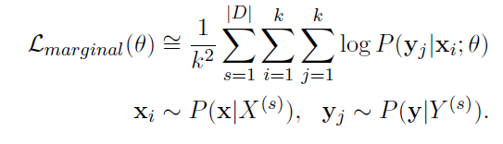
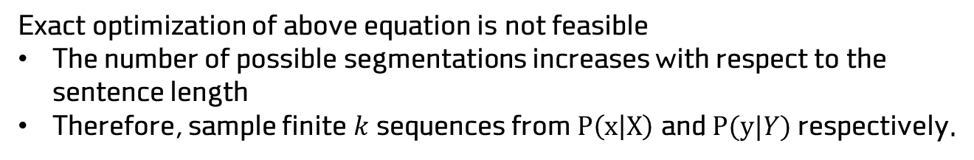
BPE
Subword Regularization
2. Subword Regularization
Training NMT with subword regularization
Exact optimization of above equation is not feasible
The number of possible segmentations increases with respect to the sentence length
Therefore, sample finite $k$ sequences from $P\left(x | X\right)$ and $P(y|Y)$ respectively.
* For simplicity, the author used $k=1$

Slide 18
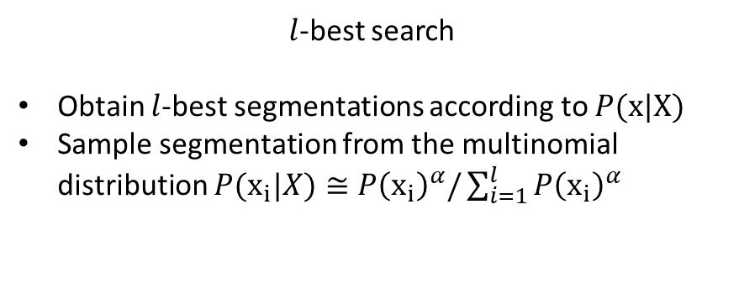
BPE
Subword Regularization
2. Subword Regularization
Training NMT with subword regularization
$l$-best search
Obtain $l$-best segmentations according to $P(x|X)$
Sample segmentation from the multinomial distribution $P(x_{i}|X)≅P{\left(x_{i}\right)}^{α}/\sum_{i=1}^{l}{P{\left(x_{i}\right)}^{α}}$

Slide 19

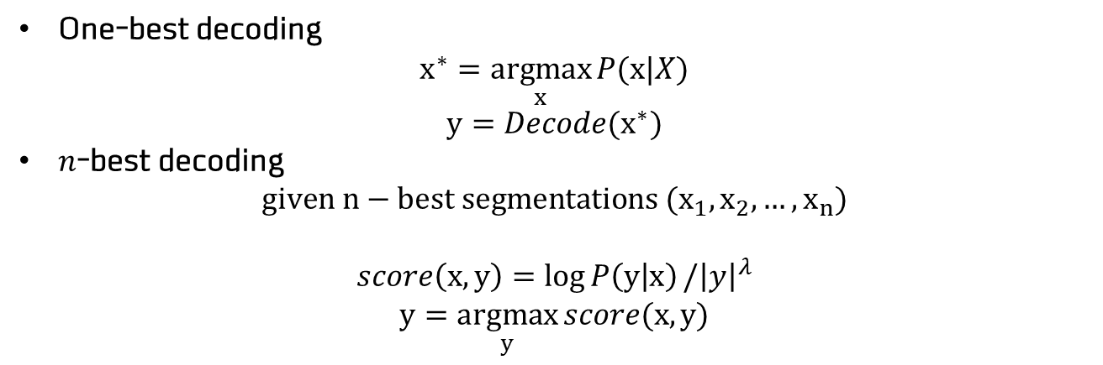
BPE
Subword Regularization
2. Subword Regularization
Training NMT with subword regularization
Decoding (Inference)
:only have raw source sentence $X$
One-best decoding
$$x^{∗}=\underset{x}{argmax}{P(x|X)}$$
$$y=Decode(x^{∗})$$
$n$-best decoding
$$given n−best segmentations (x_{1}, x_{2},…, x_{n})$$
$$score\left(x,y\right)=\log{P\left(y | x\right)}/{\left|y\right|}^{λ}$$
$$y=\underset{y}{argmax}{score(x,y)}$$

Slide 20



BPE
Subword Regularization
2. Subword Regularization
Experiments
w/o subword regularization
$$l=1$$
One best decoding
$$l=64$$
Subword regularization
n-best decoding
$$l=∞$$
6 cases

Slide 21
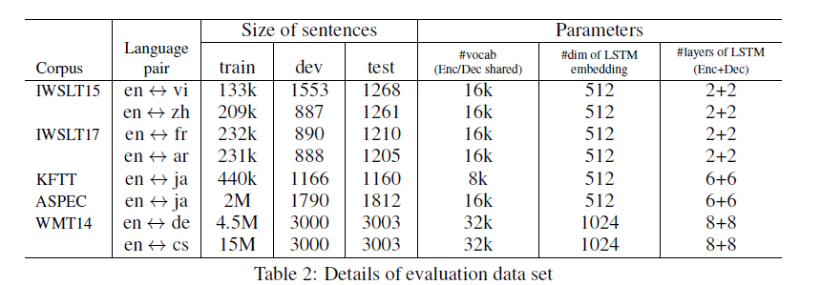
BPE
Subword Regularization
2. Subword Regularization
Experiments

Slide 22
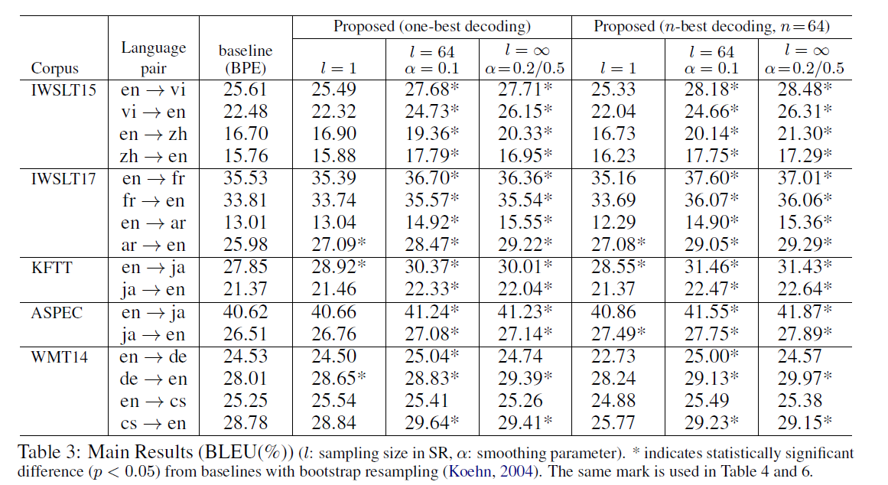
BPE
Subword Regularization
2. Subword Regularization
Experiments

Slide 23
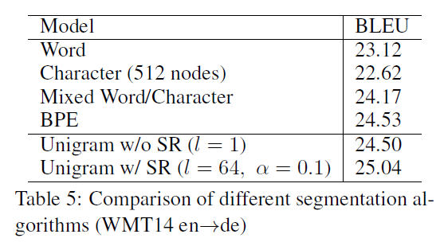
BPE
Subword Regularization
2. Subword Regularization
Experiments

Slide 24


